Slide 1

Path Finders
Kirran Kayani
Kantai melau
Chadi ghosn

Slide 2

Project Overview
Path Finders Diagram
Sources
Web scraping
ETL process
PostgreSQL
Flask app
JS Libraries
HTML & CSS
DEMO

Slide 3

Project overview
We are a group of students, looking to help our community by creating a dashboard and a website that will help all prospective students, find the best and most suitable university in the UK to apply for. In addition, it will be a great tool for universities to keep tabs on the competition and create a benchmark.

Slide 4













Project 3 | Path Finders Diagram

Slide 5
Sources
Kaggle: https://www.kaggle.com/datasets/leonler/the-guardian-league-table-main-table-20132021
The Guardian website: https://www.theguardian.com/education/ng-interactive/2021/sep/11/the-best-uk-universities-2022-rankings

Slide 6
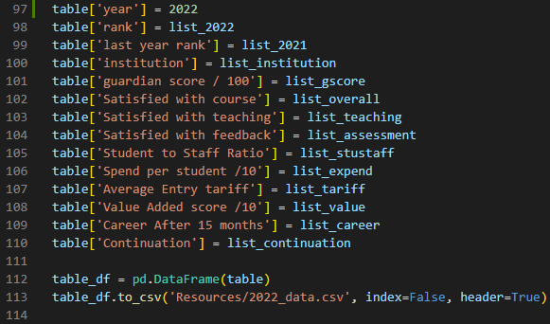
Web Scraping
Based on the Kaggle data that we downloaded, we had to scrape data from the same source to be able to append the data together.

Slide 7
ETL PROCESS
Import
Import data from Kaggle
Cleanse
Cleanse the data and make sure the inconsistencies are fixed
Import
Import the data exported from the web scraping code
Append
Append all data together
Push
Push data to a PostgreSQL DB as we need a structured db.:
Nonbinary data | Need to create Facts and Dims for reporting use
Export
Export data as json file to be used with JS

Slide 8
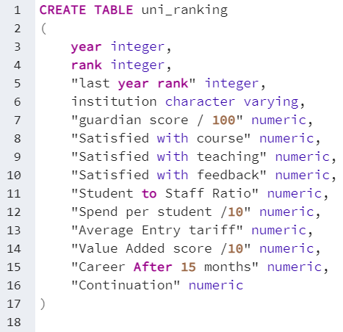
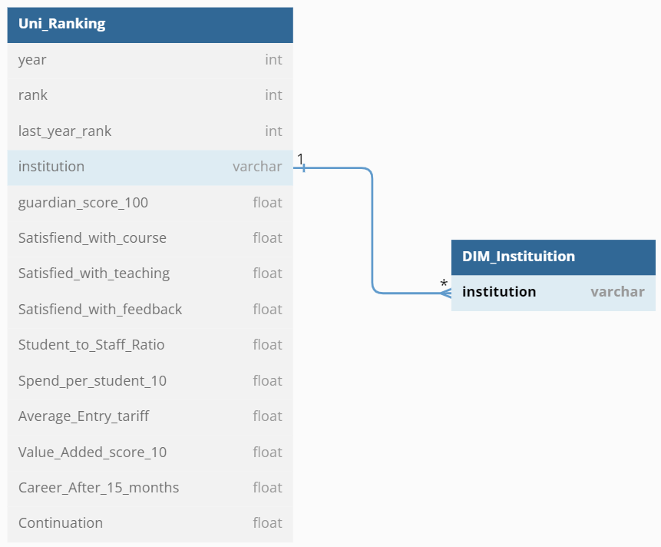
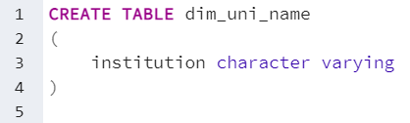
PostgreSQL
Our entity relational model will consist of a Fact table and a Dimension
We created a database called Uni_Rankings
In addition, we created a fact table called uni_ranking and a dimension called dim_uni_name

Slide 9
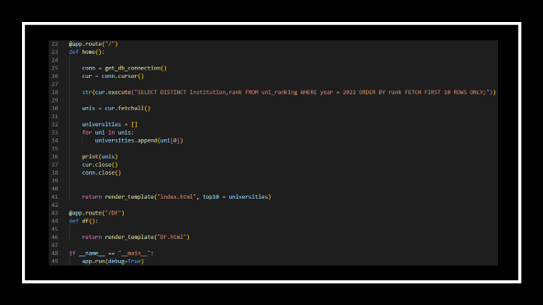
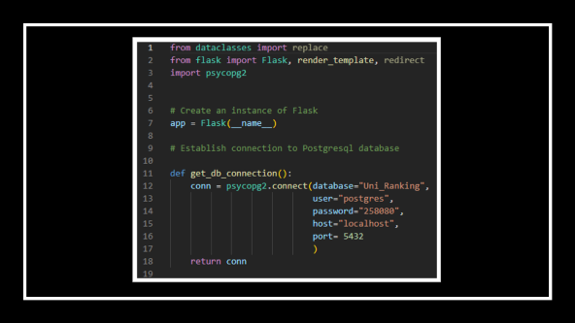
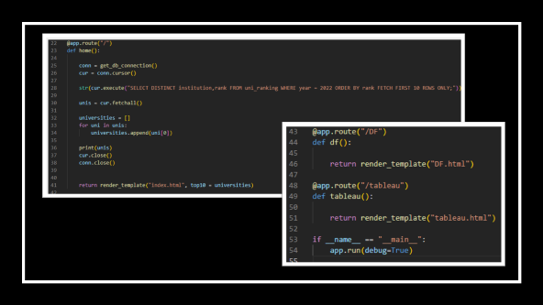
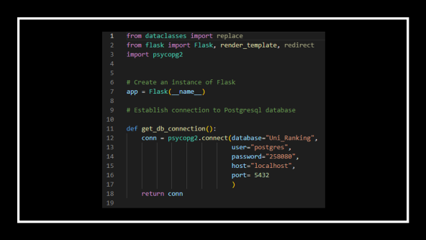
Flask app
The flask app will host the html website that we created
It will connect to the PostgreSQL database
A SQL code will query the DB for the top 10 universities by rank
Three routes are created for the two html pages created as well as the Tableau report.

Slide 10
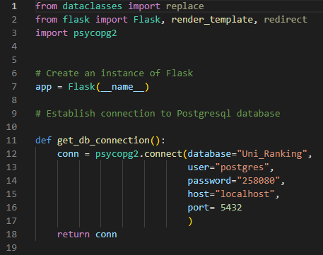

Slide 11
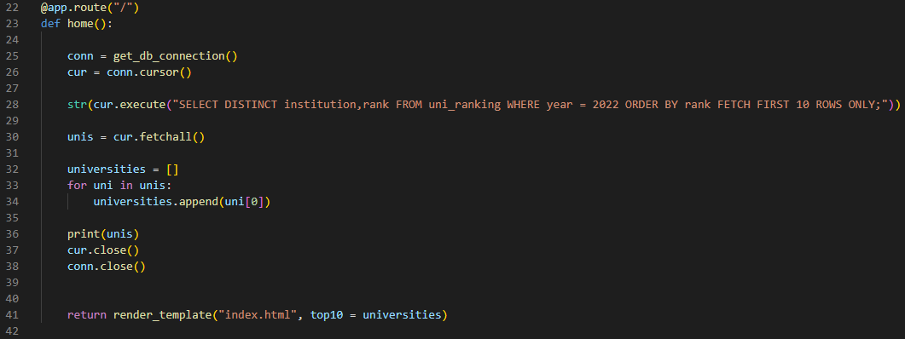
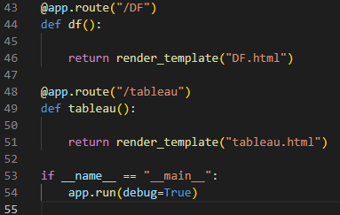

Slide 12
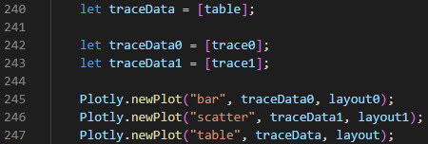
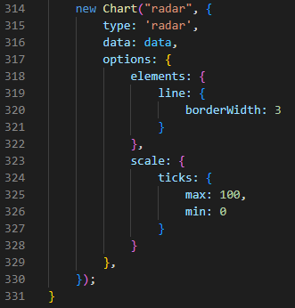
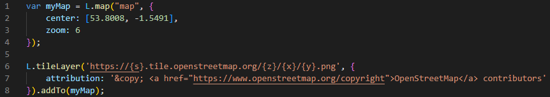
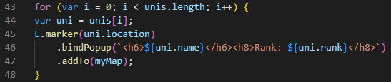
JavaScript Libraries
We used 3 main libraries in our website:
Plotly.js:
Used to create a bar chart, scatter graph and a table.
Charts.js
Used to create a radar visual for university benchmarking.
Leaflet.js
Used to map out the top universities.
1.
2.
3.1
3.2

Slide 13
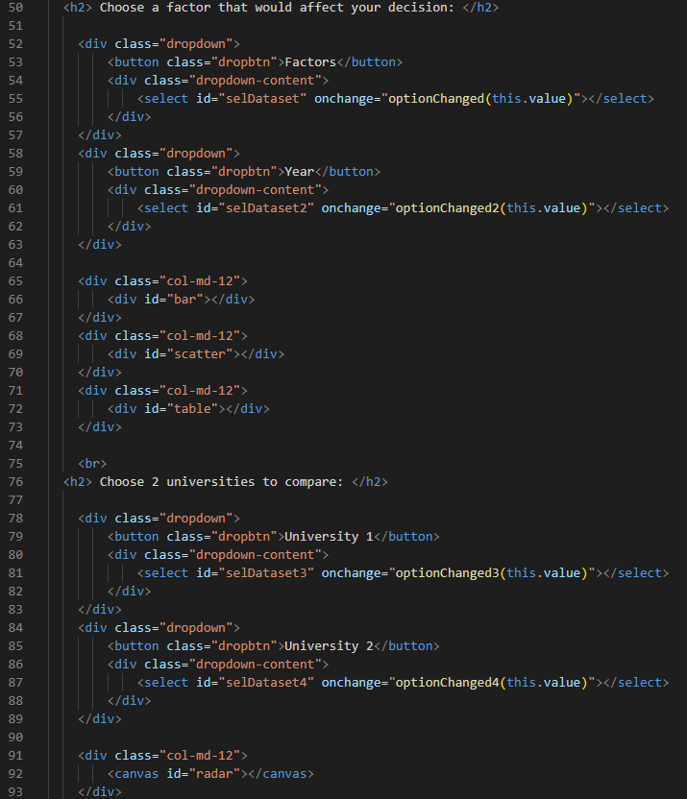
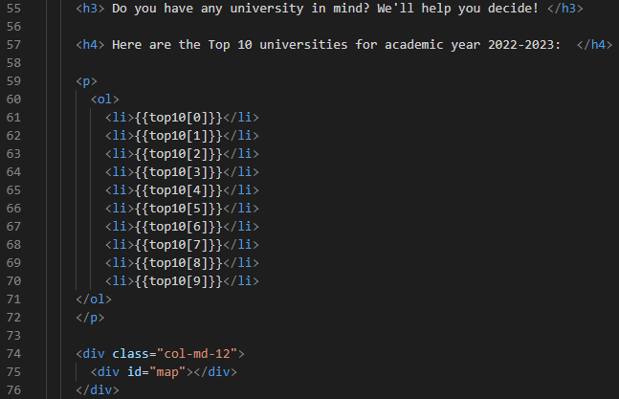
HTML & CSS
The website consists of three pages: Home, Decision Factors and Tableau Report.
The “Home” page includes a list of the top 10 universities, as well as a map pinpointing them.
The “Decision Factors” page contains 2 graphs, a table, and a radar chart for university comparison.
Tableau Report page will host our dashboard and visualizations created and published in Tableau.
CSS was used to design the UI and UX of the website.

Slide 14

DEMO

Slide 15

Any questions?

Slide 16

Thank you

